Slide 8
Development of Workforce
Awarded 24 graduate fellowships
Goal: 17 graduate fellowships
44 papers published by our students
Goal: 34 papers

Slide 10
Diversity
FY 2011 we awarded 65 fellowships and scholarships
31 female students (48%)
25 minority students (38%).
Goal
34% for female students
30% for minority students.

Slide 11
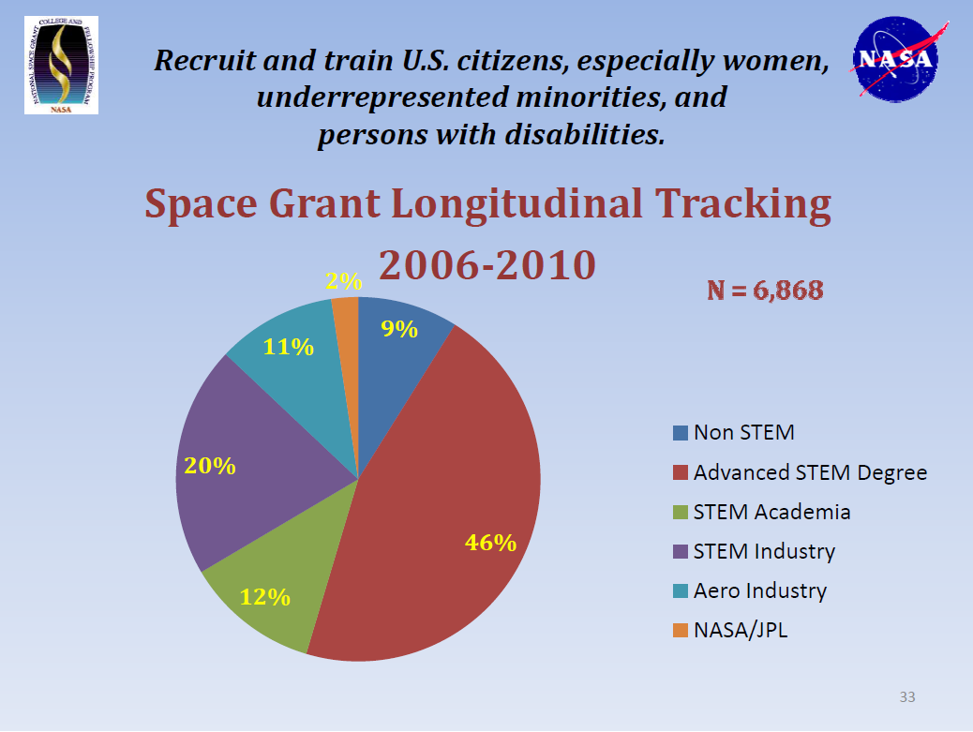

Slide 12
Student Tracking
6 fellowship students made their next career steps
advanced degree
NASA contractor
industry
academia -3
20% graduated with STEM degrees
Goal: 9%
8% pursued an advanced degree
Goal: 18%

Slide 13
Research Infrastucture
University of Utah – Geology Department
analogs for planetary exploration
Utah State University - ETE
robotics projects
Society of Hispanic and Professional Engineers (SHPE) NASA Space Science Day
Goal: 3 minigrant awards

Slide 14
Internships
LARSS interns - 2
NASA JPL
NASA Ames
USU Engineering State
Goal: 11 interns

Slide 15
Attract & retain students in STEM disciplines
10 teacher workshops
Goal: 10 workshops
4 sets of educational materials on-line
Goal: 4 sets

Slide 16
Informal Education -form strategic partnerships
Alianza Academy,
Salt Lake Center for Science Education,
Salt Lake Arts Academy,
Salt Lake Center for Science,
Space Science Institute,
Wasatch, Jackson and Woodrow Wilson Elementary schools.
Goal: 4 partnerships

Slide 17
Funding update
2011 Augmentation
award notice being processed (60 days)
$215,000
2012 Space Grant base funding
Annual report submitted Apr 27, 2012
$575,000
2012 Augmentation
TBD

