Slide 1
NASA EPSCoR programs
Research Infrastructure Development
Aerospike Thrusters-Stephen Whitmore-USU
Travel Augmentation 2011

Slide 2
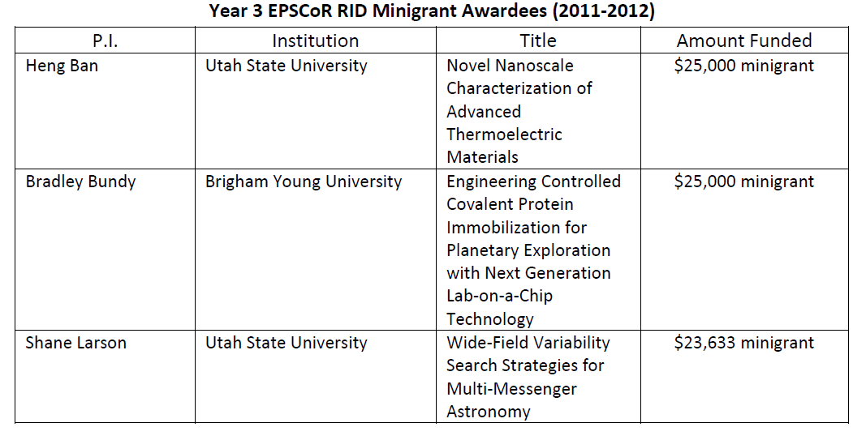
Research Infrastructure Development

Slide 3
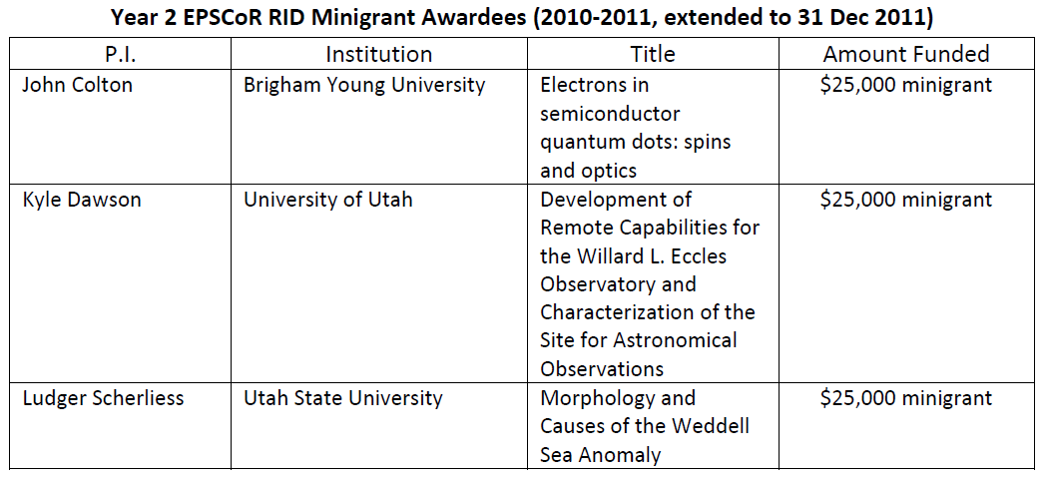
Research Infrastructure Development

Slide 4
Annual Progress Report
30 students supported
8 graduate students
7 females (23%)
1 minority (4.5%)
Collaboration with industrial firms
Philips Medical
Campbell Scientific
Apogee, Inc.
Juniper Systems
ATK
Visidyne, Inc.
Solar Conduit

Slide 5
Publications
1 submitted
1 published
8 meeting presentations

Slide 6
Grant proposals
Bradley Bundy ACS Petroleum Research $100,000
Bradley Bundy DARPA $300,000
Heng Ban NASA MSFC $10,000
John Colton NSF
Robert Wayne Springer NSF $250,000
Kevin Jim Air Force $500,000

Slide 7
New and Revised Courses
USU ECE 5930 - Small Imager Design
USU ECE 5140 - Electrical Energy Engineering
USU ECE 6140 – Adv. Electrical Energy Engineering
USU ECE 5930 - Wind Turbine System Design
UU ASTR5015 – Observ. Methods and Data Analysis
UU Phys 4060 - Popular Observational Astronomy

Slide 8
Aerospike Thrusters for IN-Space and Planetary Ascent/Descent Applications
Stephen A. Whitmore, Associate Professor
Mechanical and Aerospace Engineering
Utah State University
Ending 4 Sep 2012
Selected for funding from 5 other proposals submitted

Slide 9
Research Success
2 journal publications
6 presentations at meetings
5 NASA articles
2 patents
4 grant proposals
24 participants
3 faculty
7 graduate students
13 undergraduate students

Slide 10
Travel Augmentation $50k
Marshall Space Flight Center, Huntsville, AL
Heng Ban MAE USU (student)
Brad Bundy Chem Eng BYU (Jeff Wu or Prashanta Shrestha)
Goddard Space Flight Center, Greenbelt, MD
Shane Larson Physics USU(Eric Addison)
Ludger Scherliess Physics USU (Levan Lomidze)
Wayne Springer & Kyle Dawson, Physics & Astronomy UU
John Sohl Physics WSU (2 undergraduate students)
Johnson Space Center, Houston, TX
Joseph Orr & Lara Brewer Anesthesiology UU

Slide 11
Travel Augmentation 2011
5 research groups to visit NASA
Currently have no NASA-related research connections
Initiate discussions with NASA colleagues
$2,500 travel grants
Ending Sep 2012

