Slide 1
SPACE GRANT ANNUAL REPORTING
Rocky mountain space grant consortium
Kim Olson, Annual Meeting, May 7, 2012

Slide 2
Space Grant Outcomes & programmatic elements
OUTCOME 1
Fellowships/Scholarships
Research Infrastructure
Higher Education
OUTCOME 2
Precollege
OUTCOME 3
Information Education

Slide 3
RMNSGC Goals
OUTCOME 1 - Contribute to the development of the STEM Workforce with programs, projects and activities that are in direct alignment with NASA’s education strategic goals.
OUTCOME 2 - To attract and retain students and teachers (K-12) in the STEM disciplines who have a solid understanding of the subject material.
OUTCOME 3 - Conduct an Informal Education program to form partnerships and linkages between STEM formal and informal providers leading to an expansion of the nation’s future STEM workforce through awareness of the mission of NASA and the promotion of STEM literacy.

Slide 4
Programmatic elements defined
Fellowships/Scholarships
Student awards to graduates (fellowships) and undergraduates (scholarships) at three research universities
Research Infrastructure
Promoting development of research in an organization, includes seed money for research, proposal writing, establishing research collaborations
Higher Education
Activities which benefits either students, faculty or both. Includes curriculum development, hands-on activities, senior projects – promotes the use of mentors and role models as well as establishing interdisciplinary courses and projects
Precollege
Programs and activities that enhance and broaden the knowledge of both teachers and students (K-12), includes teacher preparation/enhancement, curriculum development and student opportunities. Such activities occur in a formal education setting
Informal Education
Involves programs/projects that serve the public-at-large and promote awareness of the mission of NASA and the promotion of STEM literacy

Slide 5
Rmnsgc affiliates
Fellowships/Scholarships
UU, BYU, USU
Research Infrastructure
UU, BYU, USU
Higher Education
UU, BYU, USU, Weber, SUU, UVU, Snow, Dixie, SLCC, Westminster, UCAT, Leonardo
Precollege
Westminster, Clark Planetarium, Hill Aero Museum, USU
Informal Education
Leonardo, Clark Planetarium, Hill Aero Museum

Slide 6
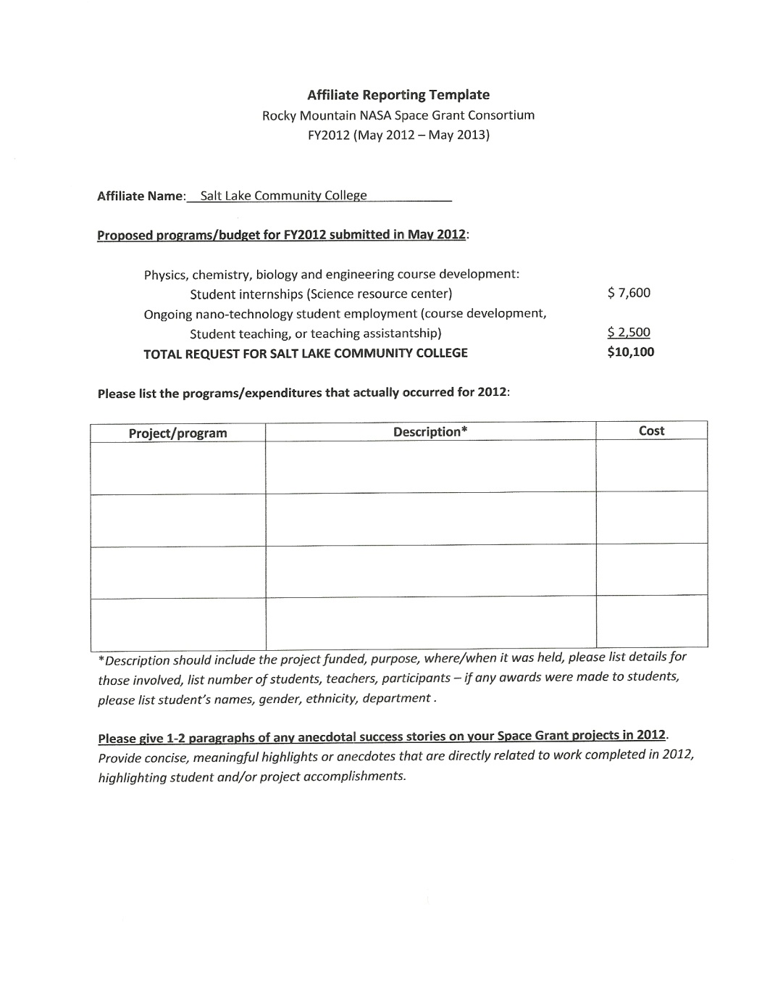
Affiliate reporting Template to be used for FY2012 reporting

Slide 7
timelines
Annual report of activities and budget proposal due 60 days prior to grant renewal date
grant renewal date: May 6, 2013 March 5, 2013
For FY2010, report was due March 25, 2011
For FY2011, report was due May 7, 2012
Feedback on possibility of moving annual meeting to March/April to facilitate annual reporting and collection of inputs from affiliates
THANK YOU to all affiliates for providing reporting, budgets and cost share forms on time this last cycle

